Slide 1
Data Structures?

Slide 2
Real-Life Examples of Data Structures
1. You have to store social network “feeds”. You do not know the size, and things may need to be dynamically added.
2. You need to store undo/redo operations in a word processor.
3. You need to evaluate an expression (i.e., parse).
4. You need to store the friendship information on a social networking site. I.e., who is friends with who.
5. You need to store an image (1000 by 1000 pixels) as a bitmap.

Slide 3
6. To implement printer spooler so that jobs can be printed in the order of their arrival.
7. To implement back functionality in the internet browser.
8. To store the possible moves in a chess game.
9. To store a set of fixed key words which are referenced very frequently.
10. To store the customer order information in a drive-in burger place. (Customers keep on coming and they have to get their correct food at the payment/food collection window.)
11. To store the genealogy information of biological species.

Slide 4
Applications of Stack
stack of plates/books in a cupboard.
A garage that is only one car wide. To remove the first car in we have to take out all the other cars in after it.
Wearing/Removing Bangles.
Back/Forward stacks on browsers.

Slide 5
Applications of Queue
A real-world example of queue can be a single-lane one-way road, where the vehicle enters first, exits first.
Queues at the ticket windows and bus-stops.
Queue of processes in OS.
Queue of packets in data communication.
Queue of air planes waiting for landing instructions.

Slide 6
Linked list Applications
Consider the history section of web browsers, where it creates a linked list of web-pages visited, so that when you check history (traversal of a list) or press back button, the previous node's data is fetched.
One common sighted example is low level memory management (i.e. the heap as managed by malloc in C or new in Java, etc) is often implemented as a linked list, with each node representing a used or available (free) block of memory. These blocks may be of any size, change size (combine and split), be freed or assigned in any order, and reordered. A linked list means you can keep track of all of these "nodes" and manipulate them fairly easily.

Slide 7
A simple real life example is a Train, here each coach is connected to its previous and next coach (Except first and last). In terms of programming consider coach body as node value and connectors as links to previous and next nodes.

Slide 8
Applications of trees
Computer chess games build a huge tree (training) which they prune at runtime using heuristics to reach an optimal move.
PDF is a tree based format. It has a root node followed by a catalog node(these are often the same) followed by a pages node which has several child page nodes.
Producers/consumers often use a balanced tree implementation to store a document in memory.
Though most databases use some form of B-tree to store data on the drive, databases which keep all their data in memory often use T-trees to do so.
Social networking is the current buzzword in CS research. It goes without saying that connections/relations are very naturally modelled using graphs.

Slide 9
Linear Lists
Linear is one in which each element has a unique successor.
Linear is further divided into restricted and general
Restricted- Allows insertion of data to the ends
General- Data can be inserted anywhere in the list

Slide 10
STACK
Stack is a linear data structure which follows a particular order in which the operations are performed.
The order may be LIFO(Last In First Out) or FILO(First In Last Out).

Slide 11
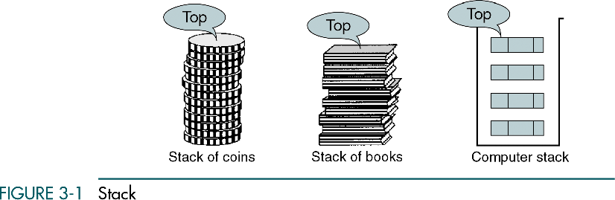
The Stack Collection
A stack is a sequence of items that are accessible only from the top of the stack.
pop
push
Other operations: isEmpty peek size
A Stack (of plates)

Slide 12
Stack Operations
Push: Adds an item in the stack. If the stack is full, then it is said to be an Overflow condition.
Pop: Removes an item from the stack. The items are popped in the reversed order in which they are pushed. If the stack is empty, then it is said to be an Underflow condition.
Peek or Stack Top : Returns top element of stack.
Is Empty: Returns true if stack is empty, else false.

Slide 13
1. The Stack Collection: Stack Operations
A stack is a Last In, First Out (LIFO) data structure in which all insertions and deletion are restricted to one end called a top
Three basic stack operations
- Push
- Pop
- Stack Top
Original slides from Data Structures a pseudocode approach with C by Gilberg, R. and Forouzan, B.

Slide 14
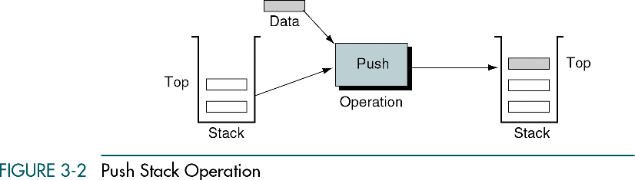
Stack Operations : Push
Push :
adds an item at the top of the stack
after the push, the new item becomes the top
the stack is in an overflow state if there is no room for the new item
Original slides from Data Structures a pseudocode approach with C by Gilberg, R. and Forouzan, B.

Slide 15
Stack Operations : Pop
Pop
when a stack is popped, the item at the top of the stack is removed and return it to the user
as the top item has been removed, the next older item in the stack becomes the top
when the last item in the stack is deleted, it must be set to its empty state
if pop is called when the stack is empty, then it is in an underflow state
Original slides from Data Structures a pseudocode approach with C by Gilberg, R. and Forouzan, B.

Slide 16
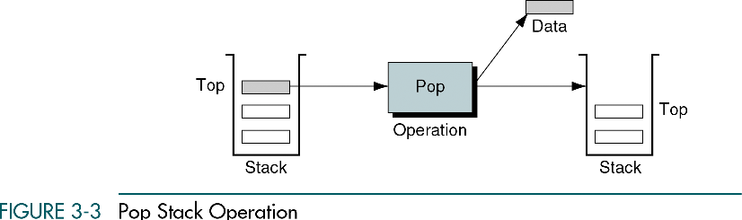
Stack Operations : Pop
Original slides from Data Structures a pseudocode approach with C by Gilberg, R. and Forouzan, B.

Slide 17
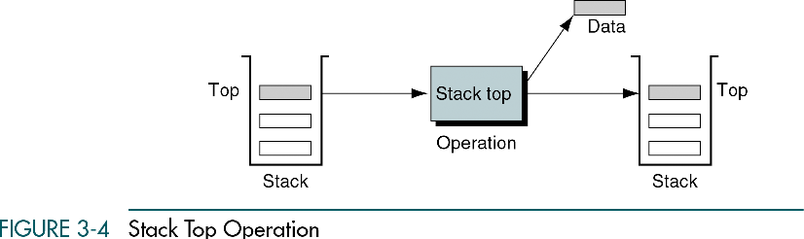
Stack Operations : Stack Top
Stack Top
copies the item at the top of the stack
it returns the data in the top element to the user but does not delete it
stack top can also result in underflow if the stack is empty
Original slides from Data Structures a pseudocode approach with C by Gilberg, R. and Forouzan, B.

Slide 18
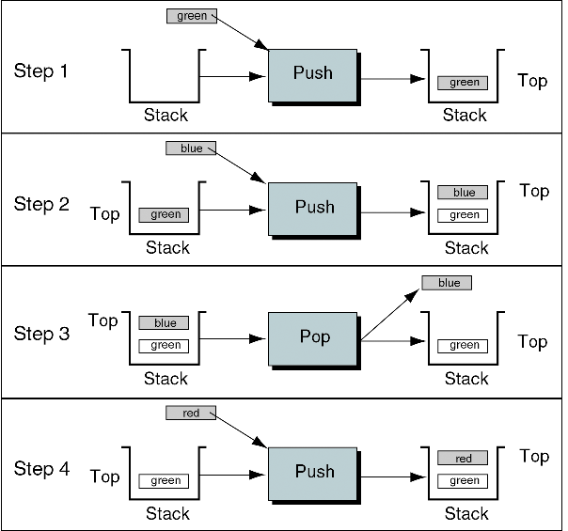
Stack operations Example (1/2)
0. with an empty stack
push green into stack
push blue into stack
pop
push red into stack
Original slides from Data Structures a pseudocode approach with C by Gilberg, R. and Forouzan, B.

Slide 19
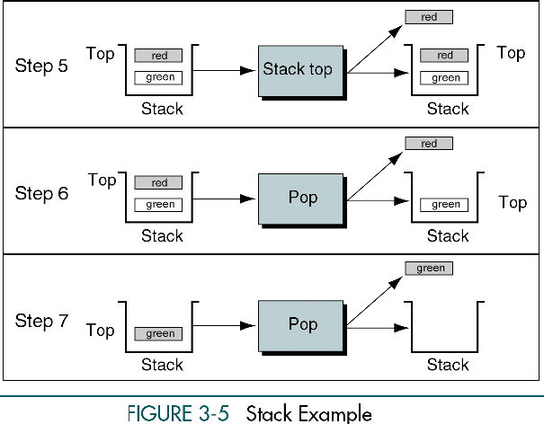
Stack operations Example (2/2)
stack top =?
pop
pop
Original slides from Data Structures a pseudocode approach with C by Gilberg, R. and Forouzan, B.

Slide 20
Stack implementation
There are several data structures that could be used to implement a stack, e.g. array or linked list
Original slides from Data Structures a pseudocode approach with C by Gilberg, R. and Forouzan, B.

Slide 21
Implementation of stack using Array
#include<stdio.h>
int stack[100],choice,n,top,x,i;
void push(void);
void pop(void);
void display(void);
int main()
{
//clrscr();
top=-1;
printf("\n Enter the size of STACK[MAX=100]:");
scanf("%d",&n);
printf("\n\t STACK OPERATIONS USING ARRAY");
printf("\n\t--------------------------------");
printf("\n\t 1.PUSH\n\t 2.POP\n\t 3.DISPLAY\n\t 4.EXIT");

Slide 22
do
{ printf("\n Enter the Choice:");
scanf("%d",&choice);
switch(choice)
{
case 1:
{
push();
break;
}
case 2:
{
pop();
break;
}

Slide 23
case 3:
{ display();
break;
}
case 4:
{ printf("\n\t EXIT POINT ");
break;
}
default:
{ printf ("\n\t Please Enter a Valid Choice(1/2/3/4)");
}
}
}
while(choice!=4);
return 0;
}

Slide 24
void push()
{
if(top>=n-1)
{
printf("\n\tSTACK is over flow");
}
else
{
printf(" Enter a value to be pushed:");
scanf("%d",&x);
top++;
stack[top]=x;
}
}

Slide 25
void pop()
{
if(top<=-1)
{
printf("\n\t Stack is under flow");
}
else
{
printf("\n\t The popped elements is %d",stack[top]);
top--;
}
}
}

Slide 26
void display()
{
if(top>=0)
{
printf("\n The elements in STACK \n");
for(i=top; i>=0; i--)
printf("\n%d",stack[i]);
printf("\n Press Next Choice");
}
else
{
printf("\n The STACK is empty");
}

Slide 27
Infix to Postfix Expression Conversion
Step 1. Add “)” to end of the Infix Expression
Step 2. Push “(“ onto STACK, and Scan s from right to left and step 3 to 6 for each element of A until the STACK is empty
Step 3. Repeat until each character in Infix Expression is scanned
If a “(“ is encountered push it onto STACK
If an operand( digit or character) is encountered add it to Postfix Expression
If a “)” is encountered, then
a. Repeatedly pop from the STACK and add to B (each operator on top of stack until “(“ is encountered
b. Discard the “(“ , i.e . Remove from the stack and do not add it to the postfix expression..
If an operator o is encountered then:
a. Repeatedly pop from STACK and add each operator (pooped from the STACK) to postfix expression which has same or higher precedence than the operator.
b. Push operator on to STACK
Step 4. Repeatedly pop from STACK and add it to the postfix expression until STACK is empty
Step 5. Exit

Slide 28
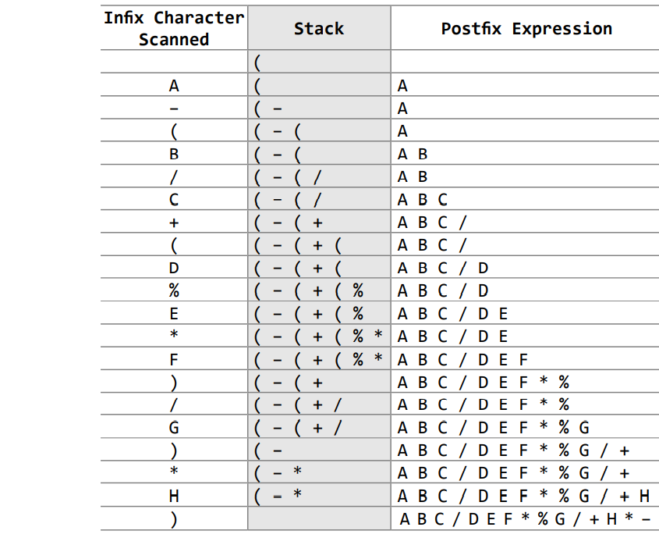
Example:A – (B / C + (D % E * F) / G)* H

Slide 29
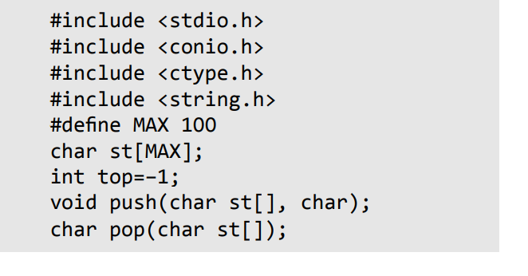
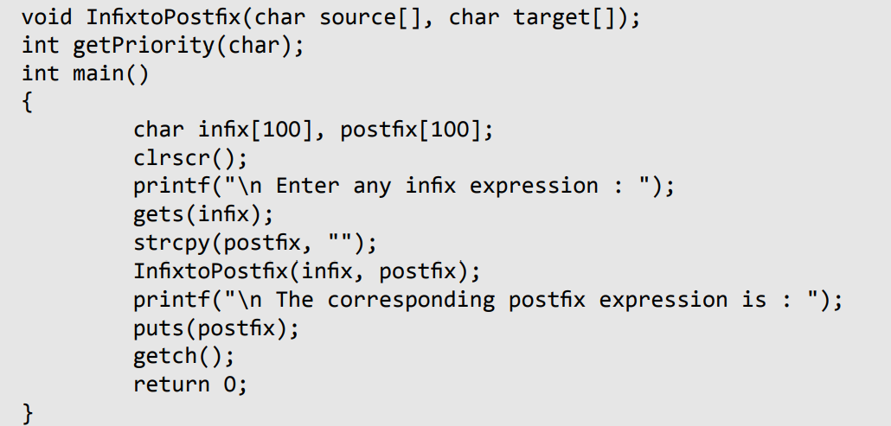

Slide 30
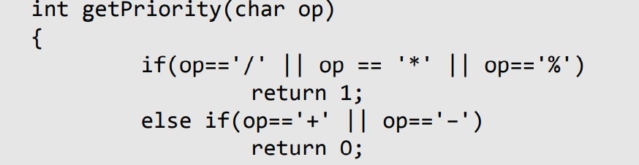
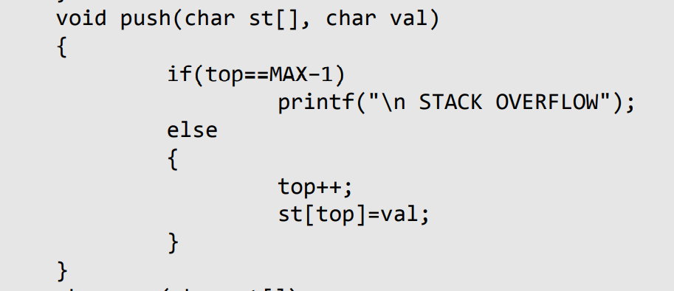

Slide 31
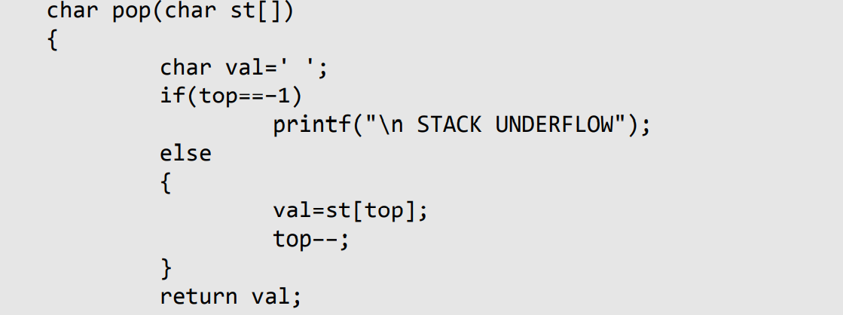

Slide 32
void InfixtoPostfix(char source[], char target[])
{ int i=0, j=0; char temp;
strcpy(target, "");
while(source[i]!='\0’)
{
if(source[i]=='(‘)
{ push(st, source[i]); i++; }
else if(source[i] == ')’)
{
while((top!=–1) && (st[top]!='(‘))
{
target[j] = pop(st);
j++; }
if(top==–1) { printf("\n INCORRECT EXPRESSION");
exit(1); }
temp = pop(st);//remove left parenthesis
i++;
}
else if(isdigit(source[i]) || isalpha(source[i]))
{ target[j] = source[i];
j++; i++; }
else if (source[i] == '+' || source[i] == '–' || source[i] == '*' || source[i] == '/' || source[i] == '%’)
{ while( (top!=–1) && (st[top]!= '(') && (getPriority(st[top]) > getPriority(source[i])))
{ target[j] = pop(st); j++; }
push(st, source[i]); i++; }
else

Slide 33
{
printf("\n INCORRECT ELEMENT IN EXPRESSION");
exit(1);
}
}
while((top!=–1) && (st[top]!='(‘))
{
target[j] = pop(st);
j++;
}
target[j]='\0’;
}

Slide 34
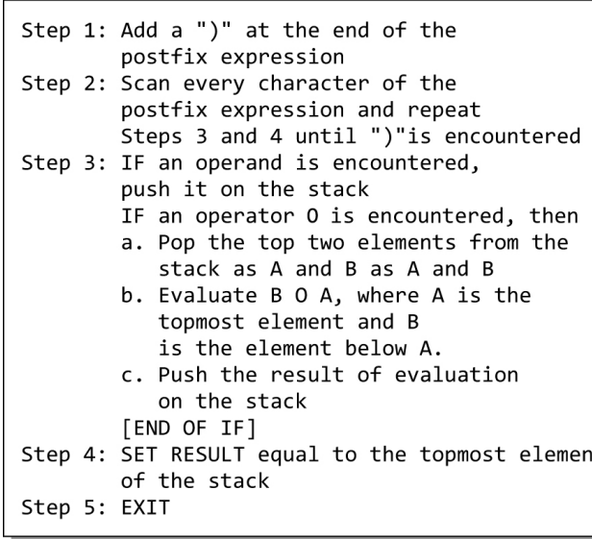
Evaluation of Postfix expression

Slide 35
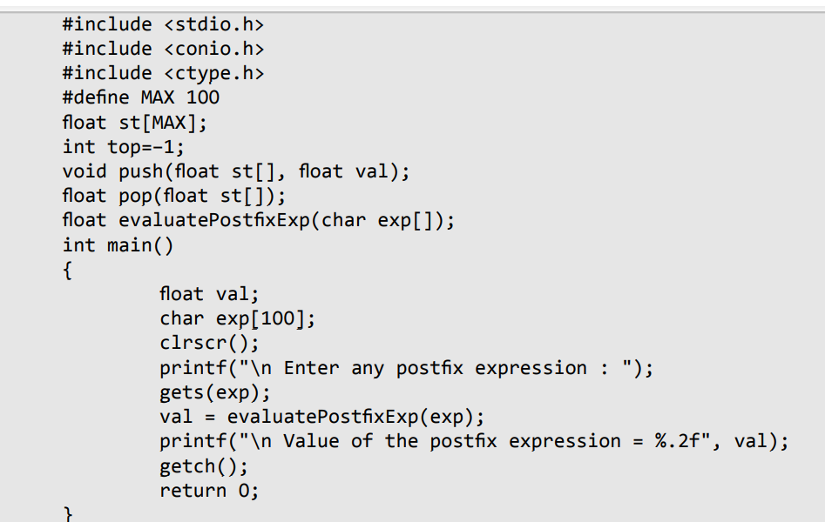

Slide 36
float evaluatePostfixExp(char exp[])
{
int i=0; float op1, op2, value;
while(exp[i] != '\0’)
{ if(isdigit(exp[i]))
push(st, (float)(exp[i]–'0'));
else
{
op2 = pop(st);
op1 = pop(st);
switch(exp[i])
{
case '+':
value = op1 + op2;
break;
case '–':
value = op1 – op2;
break;
case '/':
value = op1 / op2;
break;

Slide 37
case '*':
value = op1 * op2;
break;
case '%':
value = (int)op1 % (int)op2;
break;
}
push(st, value);
}
i++;
}
return(pop(st));
}

Slide 38
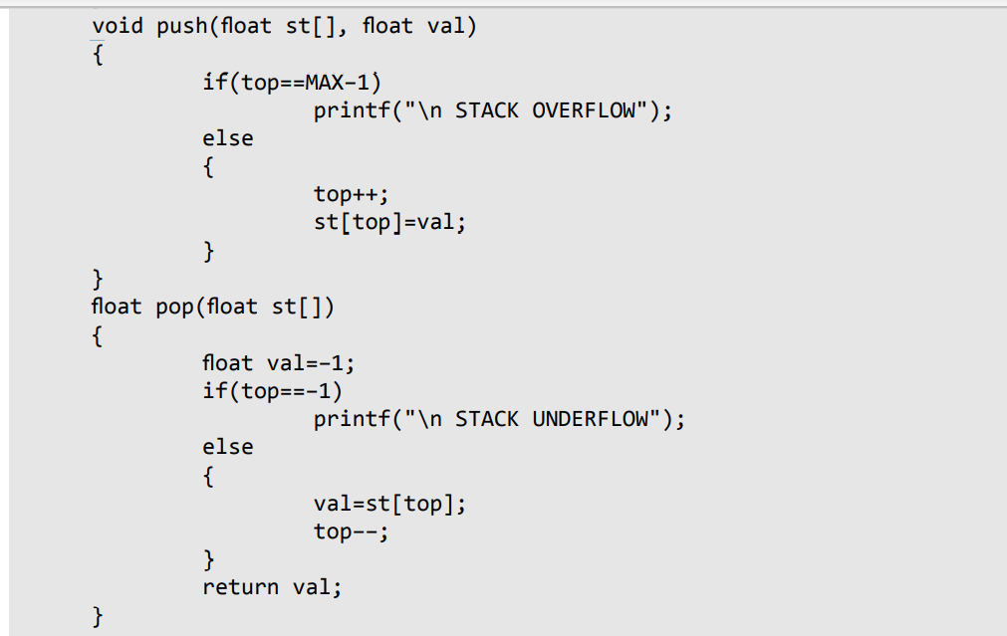

Slide 39
Recursion
A recursive function is defined as a function that calls itself to solve a smaller version of its task until a final call is made which does not require a call to itself.
Since a recursive function repeatedly calls itself, it makes use of the system stack to temporarily store the return address and local variables of the calling function.

Slide 40
Base case: One in which the problem is simple enough to be solved directly without making any further calls to the same function.
Recursive case: One in which first the problem at hand is divided into simpler sub-parts. Second the function calls itself but with sub-parts of the problem obtained in the first step. Third, the result is obtained by combining the solutions of simpler sub-part.

